Slide 1
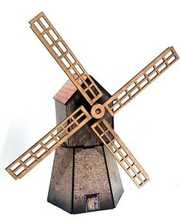
Windmill
Rotating Blades
Moving Camera

